Slide 1
Visualizing the data from FIFA 22 KPL

Slide 2
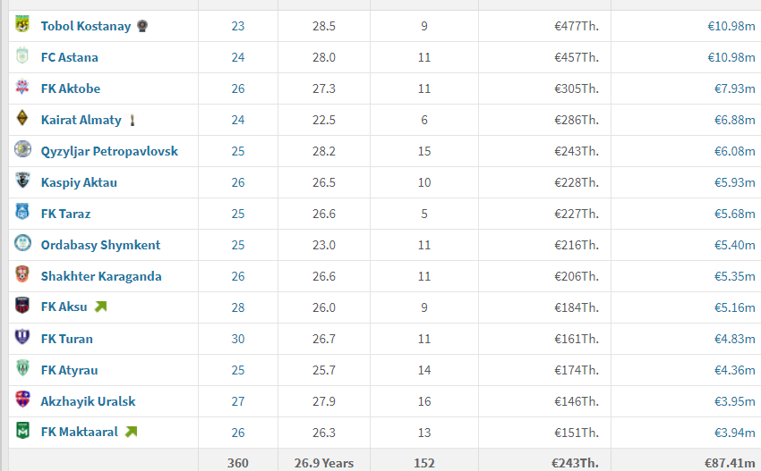
First step: implement the data of player from KPL to the game FIFA 22
1. Replace the league from the game FIFA(Cheat table can`t add new leagues but can replace the current ones)
2. 14 teams in KPL. So as I said before, we need to replace the league with 14 teams.
3. In every team there are minimum 25 players. So there we need big dataset.
Because every player have name,surname,age,weight,height,country,characteristics,price,contract also boots etc
Also in order to be realistic we need to create real kits,logos and the minifaces of players

Slide 3
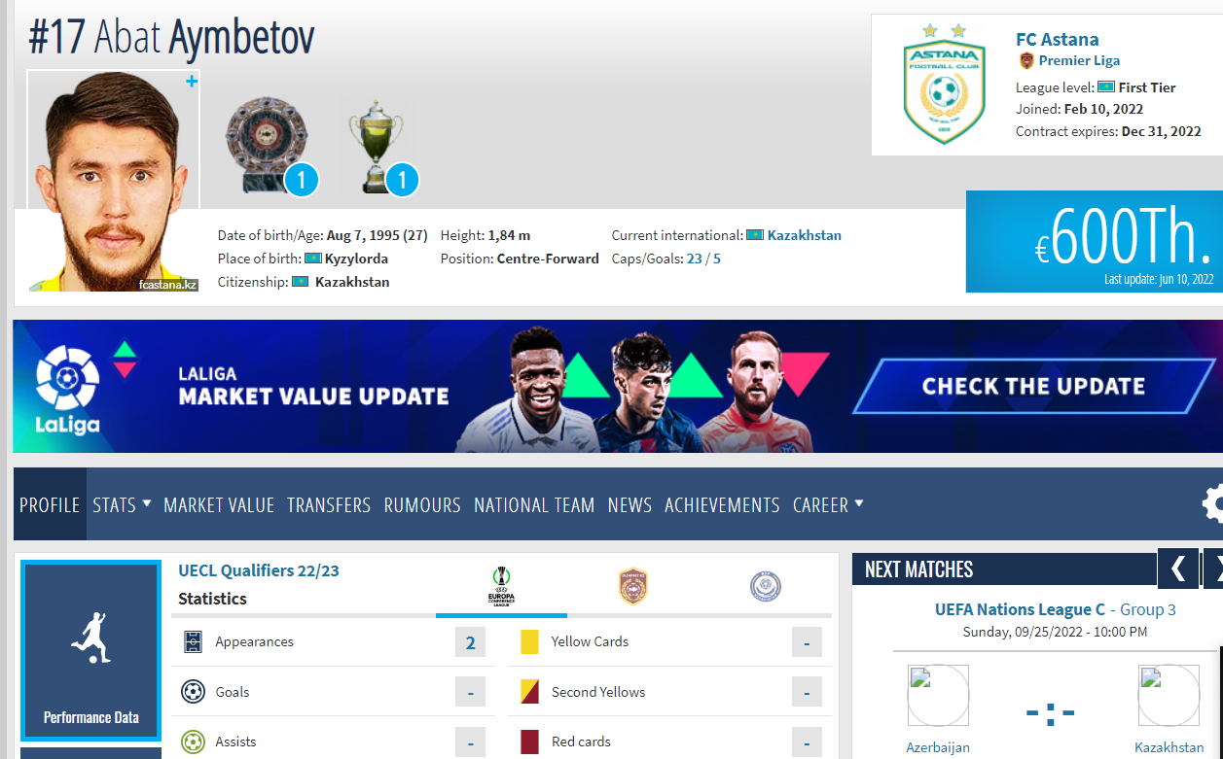
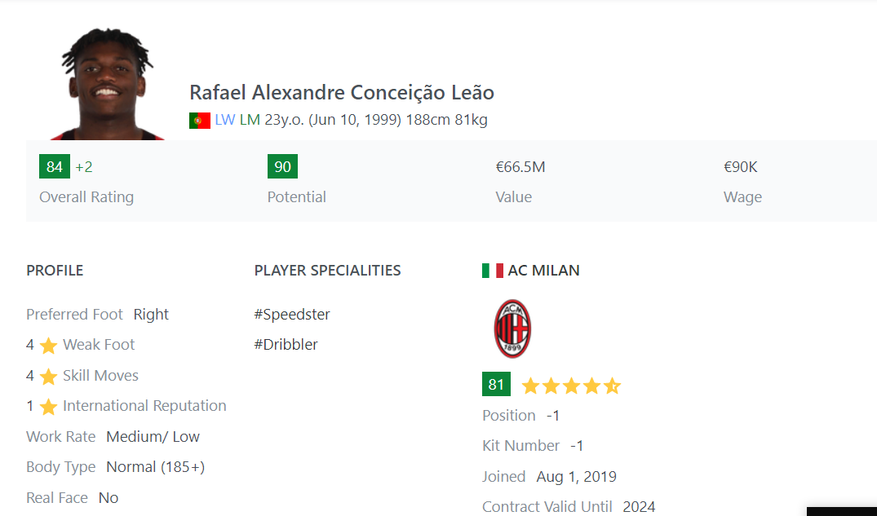
The dataset
The data of players all over the world we will take from the website transfermarkt.com
There written all information and history of all professional football world.
Also we have the website sofifa.com
In sofifa we have the data of all players and teams in the game FIFA.

Slide 4
Visualization of data after simulation in FIFA
In FIFA career mode, there is one option where we can simulate all the games of the season. (simulate:not to play by yourself. PC vs PC)
So as in reality, older player`s characteristics will be decreased. And younger perspective guys will grow.
After I will derive a completely new database that is generated from simulation based on another database.
The goal is to analyze these derived data to make predictions on potential of younger players from Kazakhstan.

